Slide 1
Chapter 4 –Dimension Reduction
Data Mining for Business Analytics in R
Shmueli, Bruce, Yahav, Patel & Lichtendahl

Slide 2
Exploring the data
Statistical summary of data: common metrics
Average
Median
Minimum
Maximum
Standard deviation
Counts & percentages

Slide 3
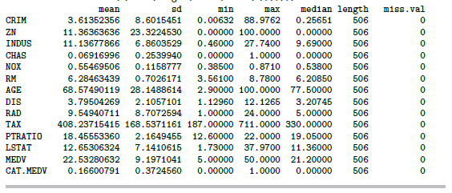
Summary Statistics for Boston Housing Data

Slide 4
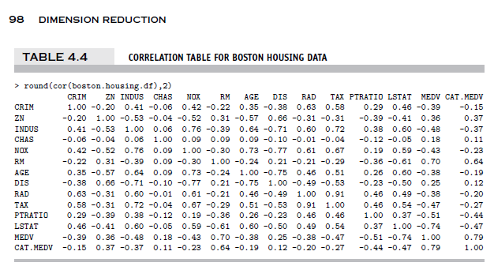
Correlation Matrix for Boston Housing Data

Slide 5
Computing Summary Statistics
# compute mean, standard dev., min, max, median,
# length, and missing values for all variables
data.frame(mean=sapply(boston.housing.df, mean), +
+ sd=sapply(boston.housing.df, sd), +
+ min=sapply(boston.housing.df, min), +
+ max=sapply(boston.housing.df, max), +
+ median=sapply(boston.housing.df, median), +
+ length=sapply(boston.housing.df, length) +
+ miss.val=sapply(boston.housing.df, function(x)
+ sum(length(which(is.na(x))))))) )

Slide 6
Using table to tabulate counts
> boston.housing.df <- read.csv("BostonHousing.csv")
> table(boston.housing.df$CHAS)
0 1
471 35
35 neighborhoods have a CHAS value of “1,” i.e. they border the Charles River

Slide 7
Using aggregate to tabulate counts using multiple variables
# create bins of size 1
boston.housing.df$RM.bin <- .bincode(boston.housing.df$RM, c(1:9))
# compute the average of MEDV by (binned) RM and CHAS
# in aggregate() use the argument by= to define the list of
# aggregating variables,and FUN= as an aggregating function.
aggregate(boston.housing.df$MEDV, by=list(RM=boston.housing.df$RM.bin,
CHAS=boston.housing.df$CHAS), FUN=mean)
RM CHAS x
1 3 0 25.30000
2 4 0 15.40714
3 5 0 17.2000
4 6 0 21.76917
5 7 0 35.96444
6 8 0 45.70000
7 5 1 22.21818
8 6 1 25.91875
9 7 1 44.06667
10 8 1 35.95000
In neighborhoods where houses averaged 3 rooms and did not border the Charles, median value was 25.3 ($000)

Slide 8
Use functions melt and cast in reshape for pivot tables
# use melt() to stack a set of columns into a single column of data.
# stack MEDV values for each combination of (binned) RM and CHAS
mlt <- melt(boston.housing.df, id=c("RM.bin", "CHAS"), measure=c("MEDV"))
head(mlt, 5)
output:
RM.bin CHAS variable value
1 6 0 MEDV 24.0
2 6 0 MEDV 21.6
3 7 0 MEDV 34.7
4 6 0 MEDV 33.4
7 0 MEDV 36.2
# use cast() to reshape data and generate pivot table
cast(mlt, RM.bin ~ CHAS, subset=variable=="MEDV",
margins=c("grand_row", "grand_col"), mean)
RM.bin 0 1 (all)
1 3 25.30000 NaN 25.30000
2 4 15.40714 NaN 15.40714
3 5 17.20000 22.21818 17.55159
4 6 21.76917 25.91875 22.01599
5 7 35.96444 44.06667 36.91765
6 8 45.70000 35.95000 44.20000
7 (all) 22.09384 28.44000 22.53281

Slide 9
Reducing Categories
A single categorical variable with m categories is typically transformed into m or m-1 dummy variables (handled automatically by most R modeling functions
Each dummy variable takes the values 0 or 1
0 = “no” for the category
1 = “yes”
Problem: Can end up with too many variables
Solution: Reduce by combining categories that are close to each other
Use pivot tables to assess outcome variable sensitivity to the dummies
Exception: Naïve Bayes can handle categorical variables without transforming them into dummies

Slide 10
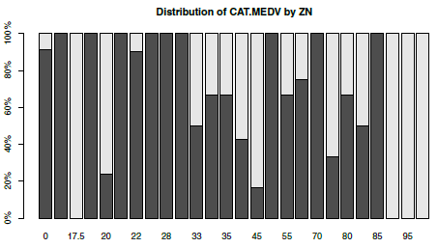
Combining Categories
Many zoning categories are the same or similar with respect to CATMEDV

Slide 11
Principal Components Analysis
Goal: Reduce a set of numerical variables.
The idea: Remove the overlap of information between these variable. [“Information” is measured by the sum of the variances of the variables.]
Final product: A smaller number of numerical variables that contain most of the information

Slide 12
Principal Components Analysis
How does PCA do this?
Create new variables that are linear combinations of the original variables (i.e., they are weighted averages of the original variables).
These linear combinations are uncorrelated (no information overlap), and only a few of them contain most of the original information.
The new variables are called principal components.
Notes:
‹#›

Slide 13
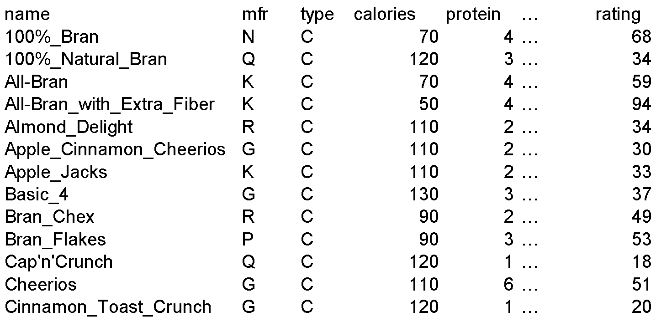
Example – Breakfast Cereals (excerpt)

Slide 14
Description of Variables
Name: name of cereal
mfr: manufacturer
type: cold or hot
calories: calories per serving
protein: grams
fat: grams
sodium: mg.
fiber: grams
carbo: grams complex carbohydrates
sugars: grams
potass: mg.
vitamins: % FDA rec
shelf: display shelf
weight: oz. 1 serving
cups: in one serving
rating: consumer reports

Slide 15
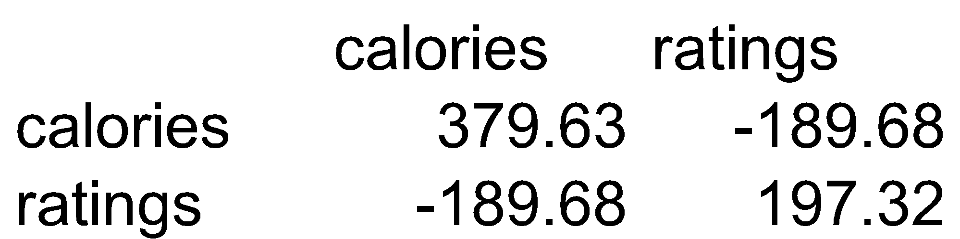
Consider calories & ratings covariance matrix
Total variance (=“information”) is sum of individual variances: 379.63 + 197.32
Calories accounts for 379.63/577 = 66%
If we want to make do with just calories, we lose 34% of the variation

Slide 16
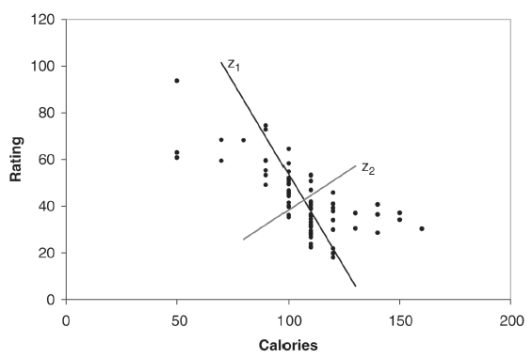
Using linear combinations to redistribute the variability in a more polarized way
Z₁ and Z₂ are two linear combinations.
Z₁ has the highest variation (spread of values)
Z₂ has the lowest variation

Slide 17
PCA output for these 2 variables
pcs <- prcomp(data.frame(cereals.df$calories, cereals.df$rating))
summary(pcs)
Weights to project original data onto Z₁ & Z_{2,} e.g. (0.847, -0.532) are weights for Z₁
PC1 PC2
cereals.df.calories 0.8470535 0.5315077
cereals.df.rating -0.5315077 0.8470535
Importance of components:
PC1 PC2
Standard deviation 22.3165 8.8844
Proportion of Variance 0.8632 0.1368
Cumulative Proportion 0.8632 1.0000
86% of the total variance is accounted for by component 1

Slide 18
Principal Component Scores for the First Five Records
PC1 PC2
[1,] -44.921528 2.1971833
[2,] 15.725265 -0.3824165
[3,] -40.149935 -5.4072123
[4,] -75.310772 12.9991256
[5,] 7.041508 -5.3576857

Slide 19
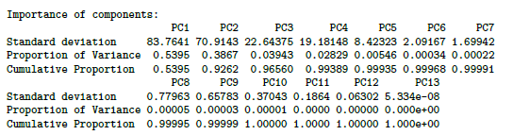
PCA for the 13 Numerical Variables in the Cereals Data
> pcs <- prcomp(na.omit(cereals.df[,-c(1:3)]))
> summary(pcs)
The first two components account for 93% of the total variance, so using 2-3 components in further modeling would probably be sufficient

Slide 20
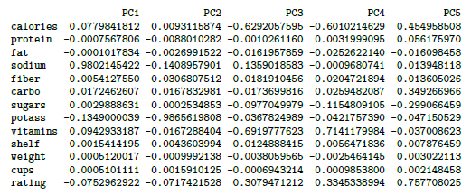
The Weightings for the First Five Components

Slide 21
Generalization
X₁, X₂, X₃, … X_{p}, original p variables
Z₁, Z₂, Z₃, … Z_{p}, weighted averages of original variables
All pairs of Z variables have 0 correlation
Order Z’s by variance (z₁ largest, Z_{p} smallest)
Usually the first few Z variables contain most of the information, and so the rest can be dropped.

Slide 22
Normalizing data
In these results, sodium dominates first PC
Just because of the way it is measured (mg), its scale is greater than almost all other variables
Hence its variance will be a dominant component of the total variance
Normalize each variable to remove scale effect
Divide by std. deviation (may subtract mean first)
Normalization (= standardization) is usually performed in PCA; otherwise measurement units affect results
> pcs.cor <- prcomp(na.omit(cereals.df[,-c(1:3)]), scale. = T)
Normalize the variables

Slide 23
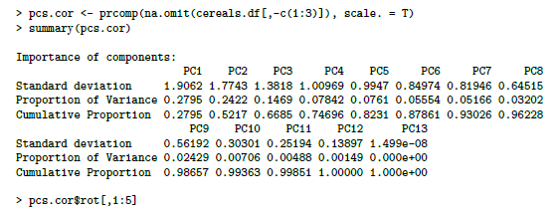
PCA Output Using all 13 Normalized Numerical Variables

Slide 24
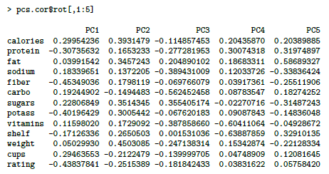
Weightings for the First Five Normalized Components

Slide 25
PCA in Classification/Prediction
Apply PCA to training data
Decide how many PC’s to use
Use variable weights in those PC’s with validation/new data
This creates a new reduced set of predictors in validation/new data

Slide 26
Regression-Based Dimension Reduction
Multiple Linear Regression or Logistic Regression
Use subset selection
Algorithm chooses a subset of variables
This procedure is integrated directly into the predictive task

Slide 27
Summary
Data summarization is an important for data exploration
Data summaries include numerical metrics (average, median, etc.) and graphical summaries
Data reduction is useful for compressing the information in the data into a smaller subset
Categorical variables can be reduced by combining similar categories
Principal components analysis transforms an original set of numerical data into a smaller set of weighted averages of the original data that contain most of the original information in less variables.

